Slide 1
Description of OA Technology
Date: March, 2016
By: Dual Aperture International
Center for Integrated Smart Sensors

Slide 2
0. OAIP Overview

Slide 3
Direct Depth technology based on Offset IR Aperture
Direct advantages over
DFD
Stereo camera
Earlier OA
Software-centric approach

Slide 4
Why call ‘direct depth’? -Compared to DFD (blur-based)-
Edge extraction not needed, maybe optional for compute time reduction purpose.
Direct disparity-based depth calculation using
correlation and its credence for thresholding and
PSF and convolution are not needed; directly correlate in the raw image domain.
Moving into the blurred domain using synthetic blurring lowers accuracy besides additional computing
Obtain absolute depth directly instead of PSF index which needs to be translated into absolute depth through calibration.
Ambiguity of depth around focal plane resolved.

Slide 5
Why call ‘direct depth’? -Compared to stereo camera-
Neither calibration nor alignment needed.
Size(two cameras + baseline), cost reduced

Slide 6
Why call ‘direct depth’? -Compared to earlier offset aperture-
In RGB offset aperture camera where R, G, and B apertures are offset from each other, RGB image restoration is too difficult.
The proposed Offset IR aperture camera uses mutually horizontally offset apertures between RGB and IR.
RGB image quality is not deteriorated except the RGB aperture can be somewhat offset from the center. [White/SIR filter desirable]

Slide 7
Why call ‘direct depth’? -Compared to earlier software(-based) approach-
Hardware design based on smart memory architecture is easier; start from basic features and gradually upgrade, i.e., scalable architecture is possible to advance with the market requirement
Extremely fast depth computing hardware design is possible using scanline processing unit design; real-time or direct (fast) availability of depth

Slide 8
Introduction
Principle of Offset Aperture (OA) depth extraction
The offset-aperture creates a disparity which varies with the object distance.
Thus, Object distance can be estimated by measuring the disparity between RGB and IR image.
(Top view)
IR image
RGB
aperture
RGB image
Near object disparity
Far object
Near object
IR
aperture
Sensor
IR image
RGB image
Fig. 0.1. Principle of OA
Far object disparity

Slide 9
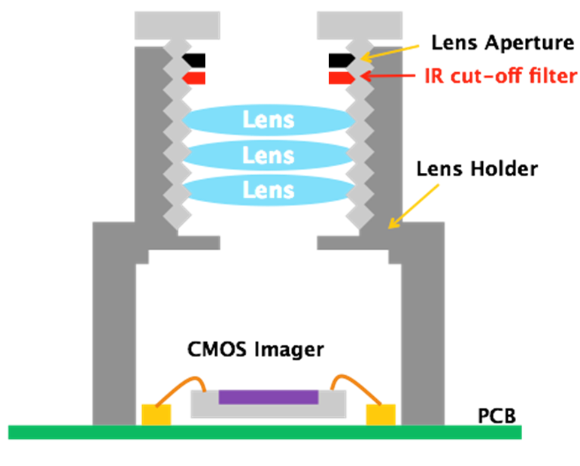
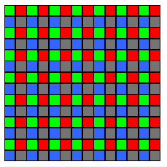
Introduction
Composition of the camera
RGB cut-off filter
RGB pass
IR pass
(b)
4 color CIS
G | R
B | IR
(c)
(a)
Fig. 0.2. Structure of the camera where (a) shows the lateral view of OA camera, (b) shows the aperture and (c) shows the four-color sensor used in the camera.

Slide 10
Introduction
Spectral characteristic
(2nd round aperture)
R G B IR
RGB cut-off filter (IR pass)
IR cut-off filter (RGB pass)
R G B
IR
(a)
(b)
Fig. 0.3. (a) Vertical cross section of the aperture and (b) the corresponding spectral response curve.

Slide 11
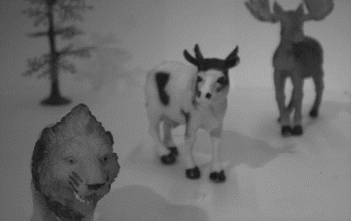
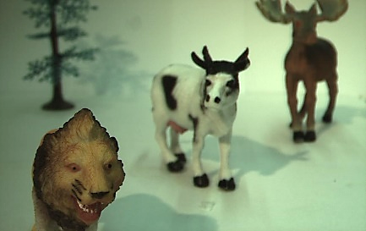
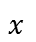
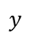
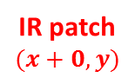
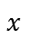
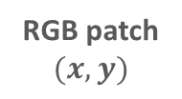
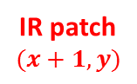
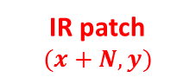
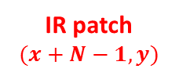
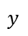
Introduction
Depth extraction algorithm for OA camera
Object distance is estimated by measuring the disparity between RGB patch and IR patch.
IR patch
$$(x+0,y)$$
IR patch
$$(x+1,y)$$
…
IR patch
$$(x+N−1,y)$$
IR patch
$$(x+N,y)$$
$$y$$
IR patches
…
RGB patch
$$(x,y)$$
IR image
Similarity measure
Similarity measure
…
Similarity measure
Similarity measure
$$x$$
Similarity
score
$$y$$
RGB patch
RGB image
Disparity
(Depth)
n
$$x$$
(b)
(a)
Fig. 0.4. Graphical illustration of depth extraction using OA camera, where (a) shows the RGB and IR images with the respective patches and (b) shows the correlation curve.

Slide 12
Introduction
DME
(Depth Map Engine)
ED
IDE-E
FDE-E
Sparse depthmap
RGB/IR image
LC
NR
GE
IDE-A
CA
FDE-A
Full depthmap
LC : Leakage compensation
NR : Noise reduction
ED : Edge detection
GE : Gradient extraction
IDE-E : Integer disparity estimation for edge pixels
IDE-A : Integer disparity estimation for all pixels
CA : Cost aggregation
FDE-E : Fractional disparity estimation for edge pixels
FDE-A : Fractional disparity estimation for all pixels
Fig. 0.5. Block diagram with the data-flow of the depth extraction system based on OA camera.

Slide 13
Introduction
Functional blocks of OAIP
Pre-processing
Leakage compensation(LC)
Noise reduction(NR)
Edge detection(ED)
Core processing
Gradient extraction(GE)
Integer disparity estimation(IDE)
Post-processing
Cost aggregation(CA)
Fractional disparity estimation(FDE)

Slide 14
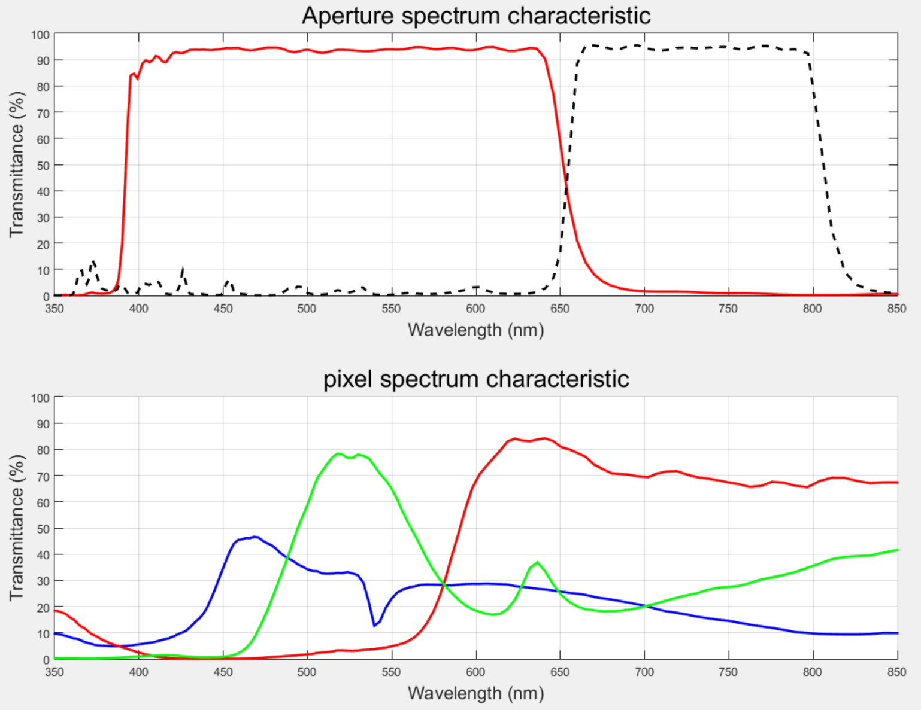
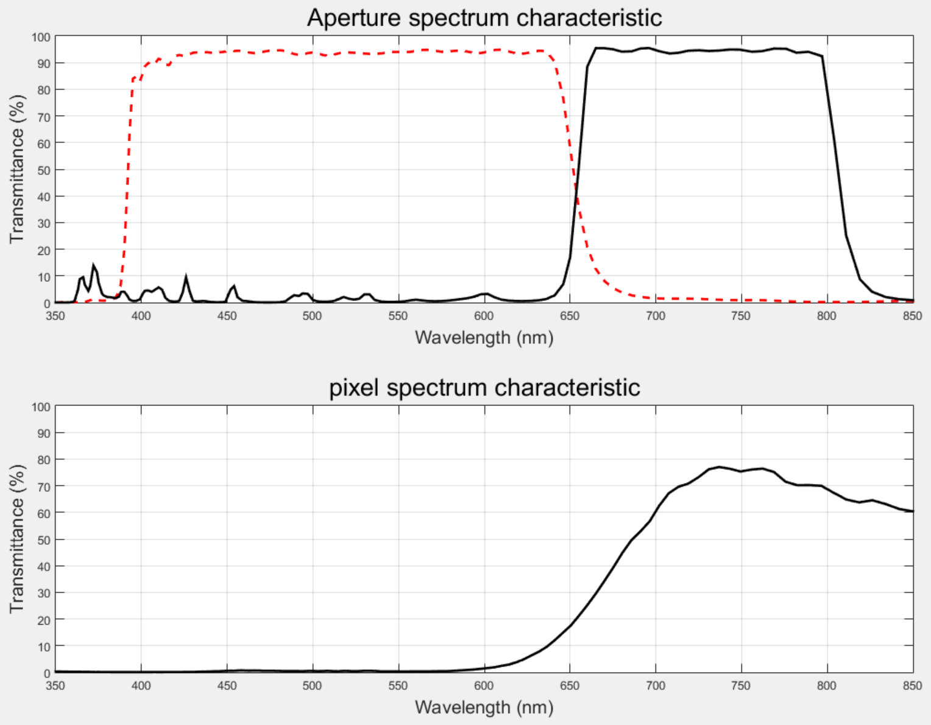
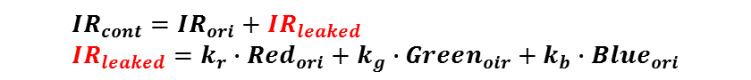
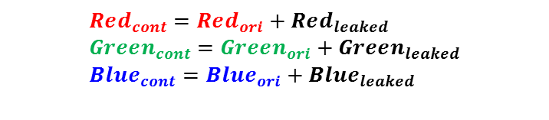
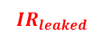
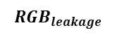
Pre-Processing
Leakage compensation(LC)
Since the RGB and IR response curves overlap, crosstalk occurs between the RGB and IR images.
We compensate for the cross-spectral crosstalk by subtracting scaled signals.
Correction is performed using the following equations.
R G B IR
IR pass filter
RGB pass filter
R G B
IR
$$RGB_{leakage}$$
$${IR}_{leaked}$$
(a)
$$Red_{cont}=Red_{ori}+Red_{leaked} \\ Green_{cont}=Green_{ori}+Green_{leaked} \\ Blue_{cont}=Blue_{ori}+Blue_{leaked}$$
$$IR_{cont}=IR_{ori}+IR_{leaked} \\ IR_{leaked}=k_{r}∙Red_{ori}+k_{g}∙Green_{oir}+k_{b}∙Blue_{ori}$$
(b)
(c)
Fig. 0.6. (a)Structure of aperture and leakage from (b) RGB to IR and from (c) IR to RGB.

Slide 15
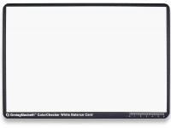
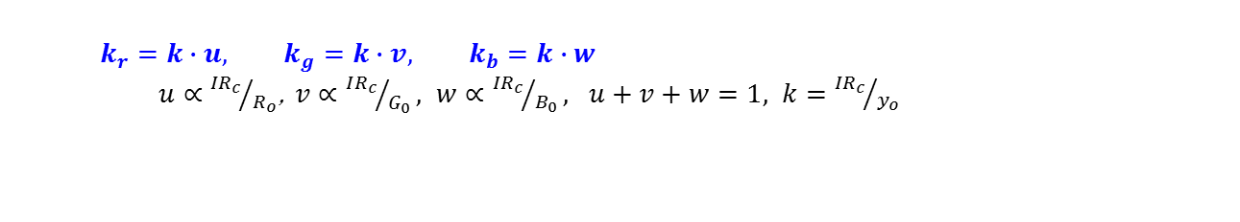
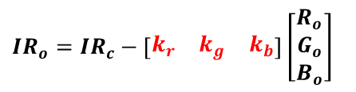
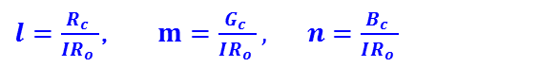
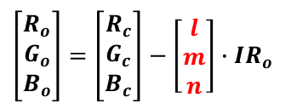
Pre-Processing
Leakage compensation(LC)
We can calculate leakage ratio of light sources by spectrum analysis.
Refinement model
$$IR_{o}=IR_{c}−\left[\begin{matrix}k_{r} & k_{g} & k_{b}\end{matrix}\right]\left[\begin{matrix}R_{o} \\ G_{o} \\ B_{o}\end{matrix}\right]$$
Block IR rays using IR cut filter
Capture the white image
→
$$k_{r}=k∙u, k_{g}=k∙v, k_{b}=k∙w$$
$u∝{{IR}_{c}}/{R_{o}}$, $v∝{IR_{c}}/{G_{0}}, w∝{{IR}_{c}}/{B_{0}}, u+v+w=1, k={{IR}_{c}}/{y_{o}}$
Fig. 0.7. White checker
$$\left[\begin{matrix}R_{o} \\ G_{o} \\ B_{o}\end{matrix}\right]=\left[\begin{matrix}R_{c} \\ G_{c} \\ B_{c}\end{matrix}\right]−\left[\begin{matrix}l \\ m \\ n\end{matrix}\right]∙IR_{o}$$
Block RGB rays using RGB cut filter
Capture the out-focus images of white target in various light conditions
→
$l=\frac{R_{c} }{IR_{o} }$, $m=\frac{G_{c} }{IR_{o} },$ $n=\frac{B_{c} }{IR_{o} }$

Slide 16
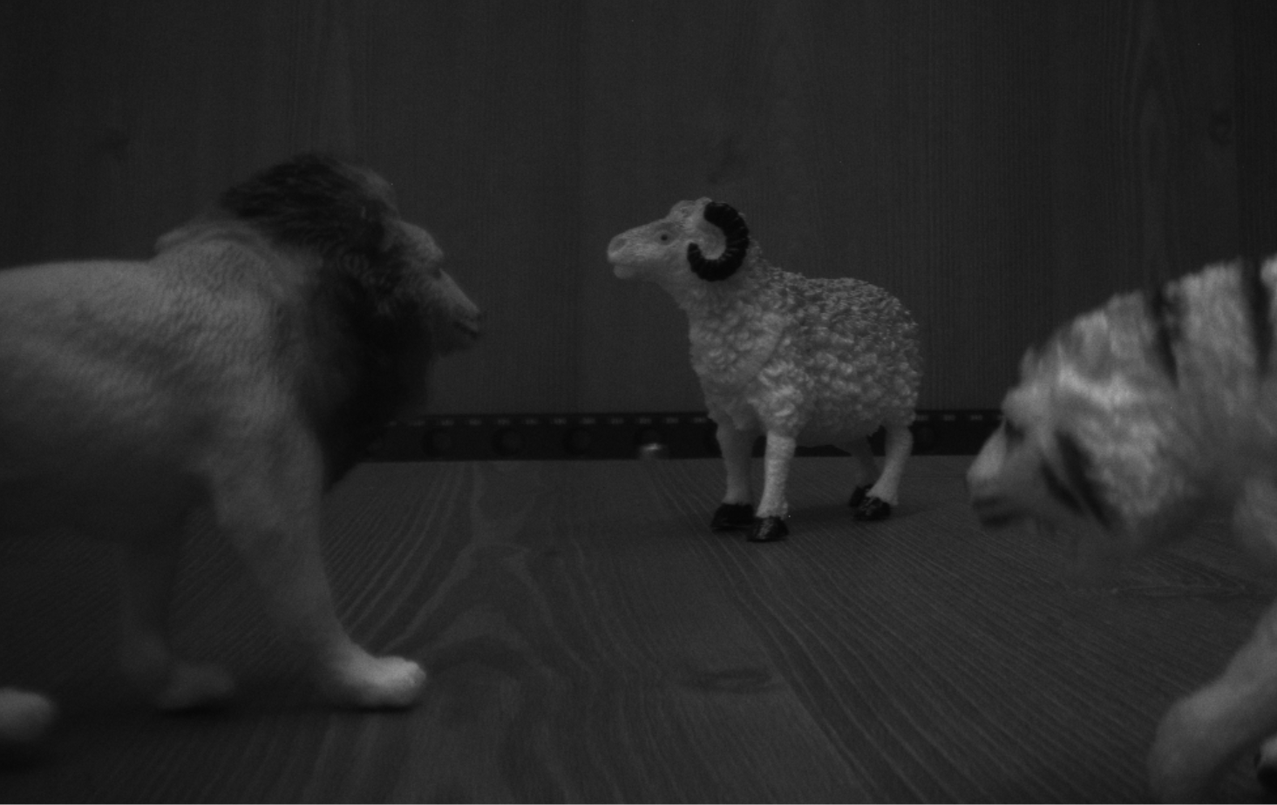
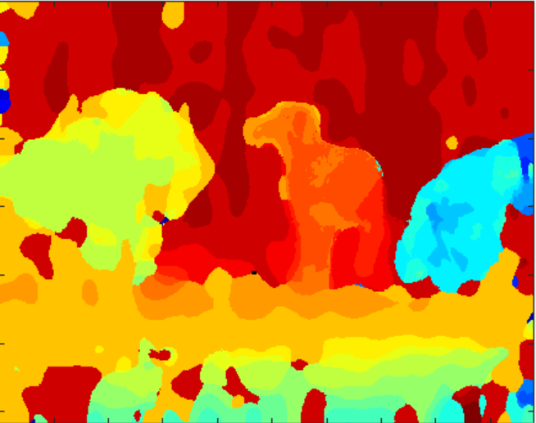
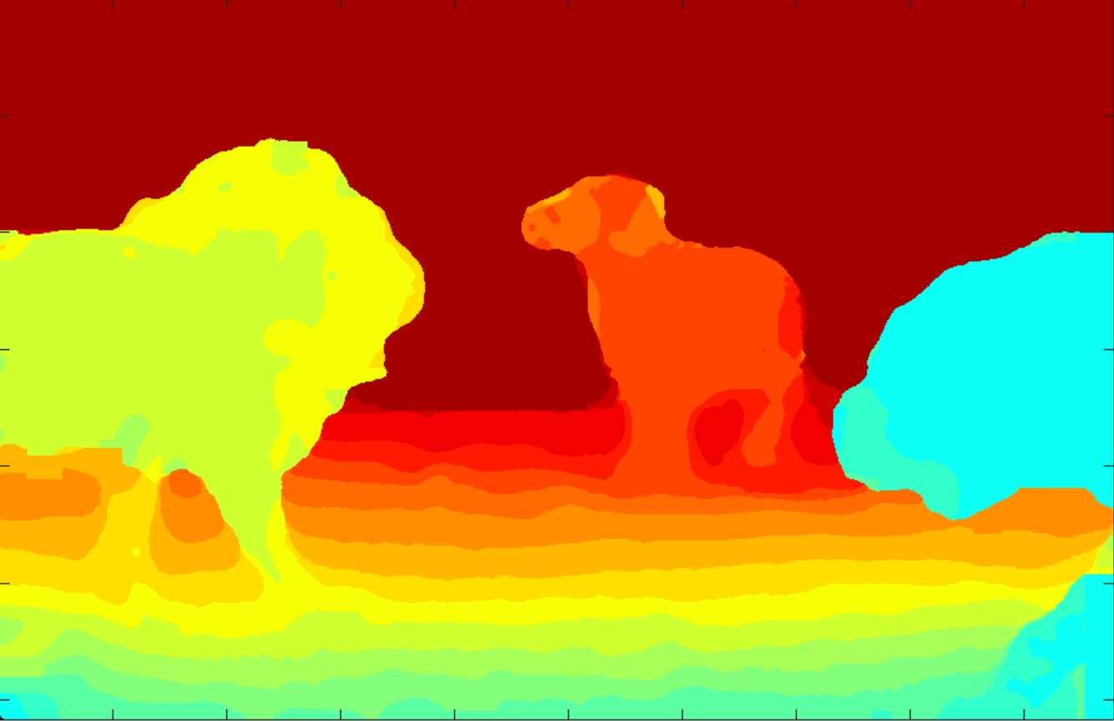
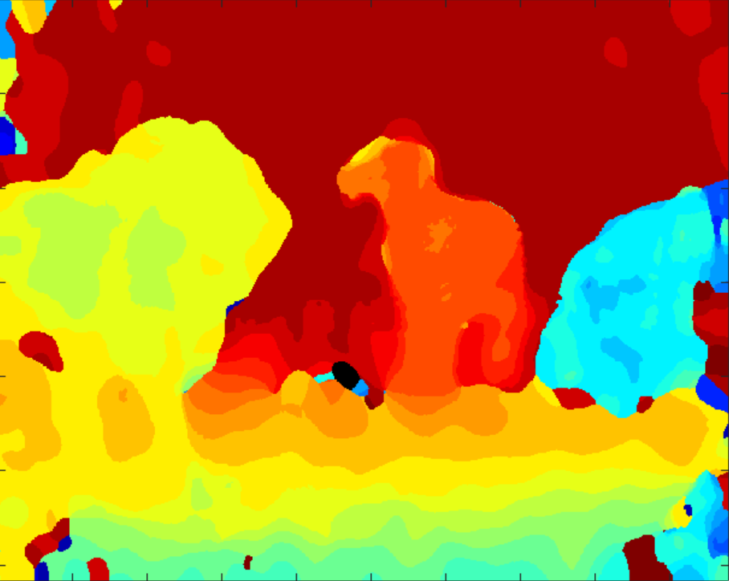
Pre-Processing
Noise reduction(NR)
The objective of this block is to
Enhance SNR(Signal to Noise Ratio)
Preserve edges and textures in the image
Our experiments show that Bilateral Filter shown the best performance based on quantitative and qualitative depthmap evaluation
(a)
(b)
(c)
(d)
Fig. 0.8. (a) Reference image, (b) depthmap extracted from the noisy image, (c) depthmap extracted from temporally averaged image (benchmark) and (d) depthmap extracted after applying bilateral filter to input images.

Slide 17
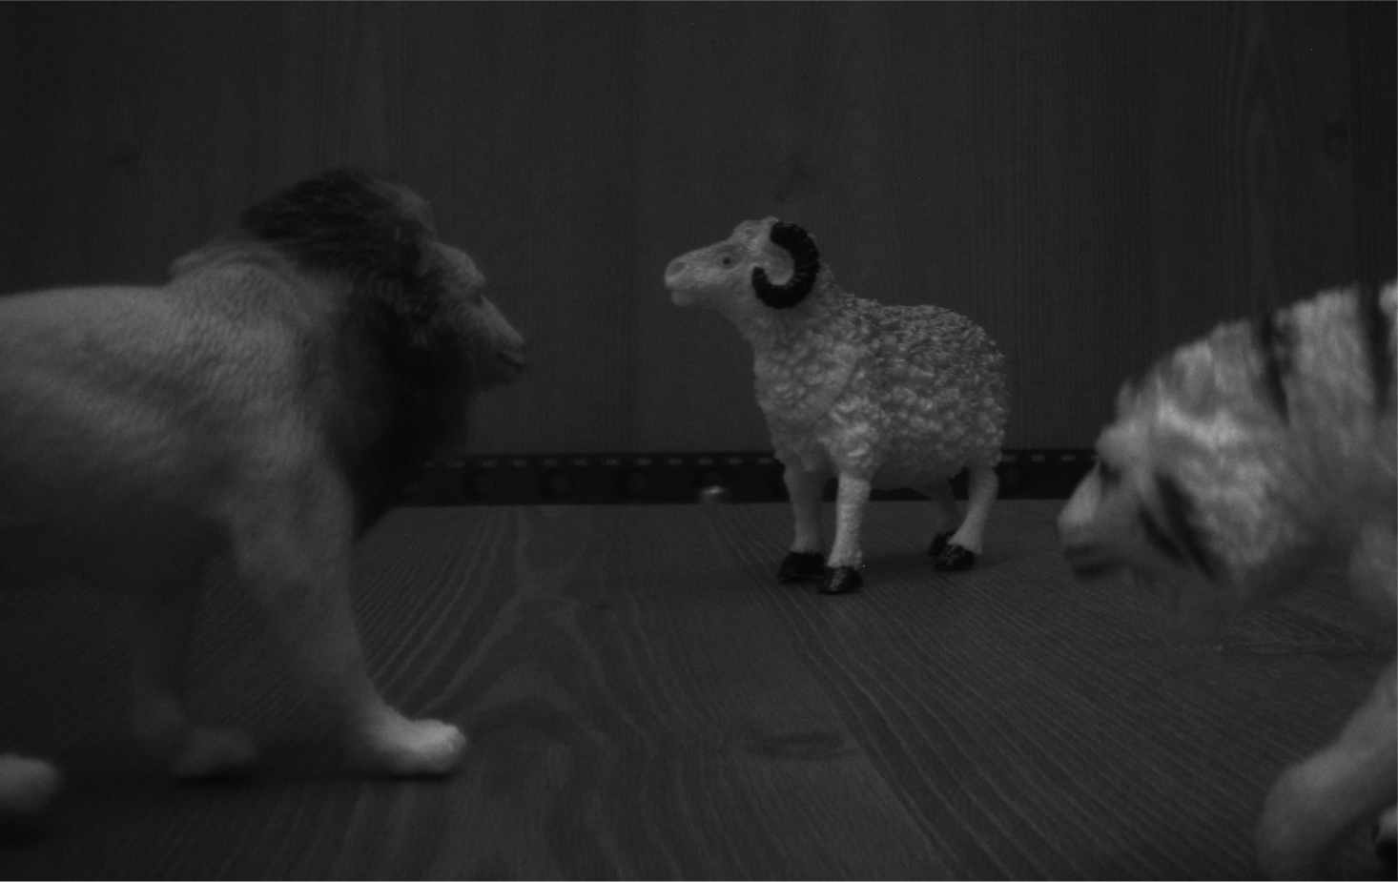
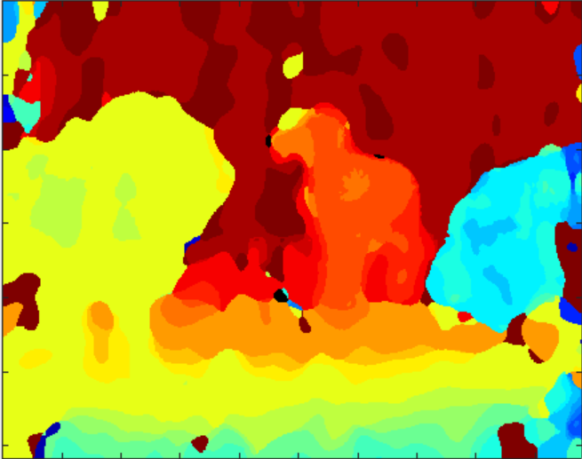
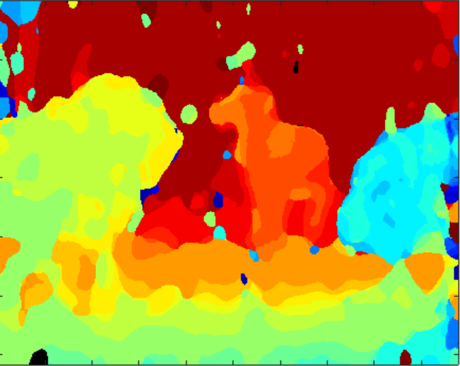
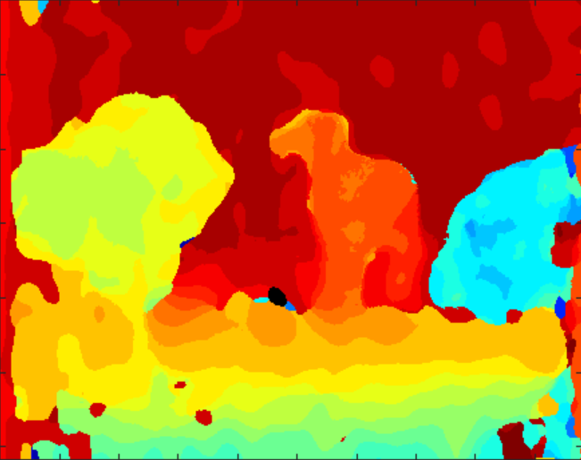
Results
(a)
Pre-Processing
(b)
(c)
(d)
(e)
(f)
Method | Error% | MSE
Box | 42% | 10.6
HSP | 41.9% | 10.5
BF | 36% | 8.1
Guided | 46.3% | 10.3
Leakage Comp
Image NR
NCC based Stereo Matching
(35x35)
Cost Agg
Guided Filter
35x35
Fig. 0.9. (a) Input scene, (b) benchmark, (c) box, (d) HSP, (e) BF, and (f) guided

Slide 18
Core Processing
Gradient extraction(GE)
Gradient exaggerates the changes in an image, resultantly, the selectivity of similarity curve with disparity is improved.
Integer disparity estimation(IDE)
NCC and ZNCC have shown the best performance based on qualitative evaluation.

Slide 19
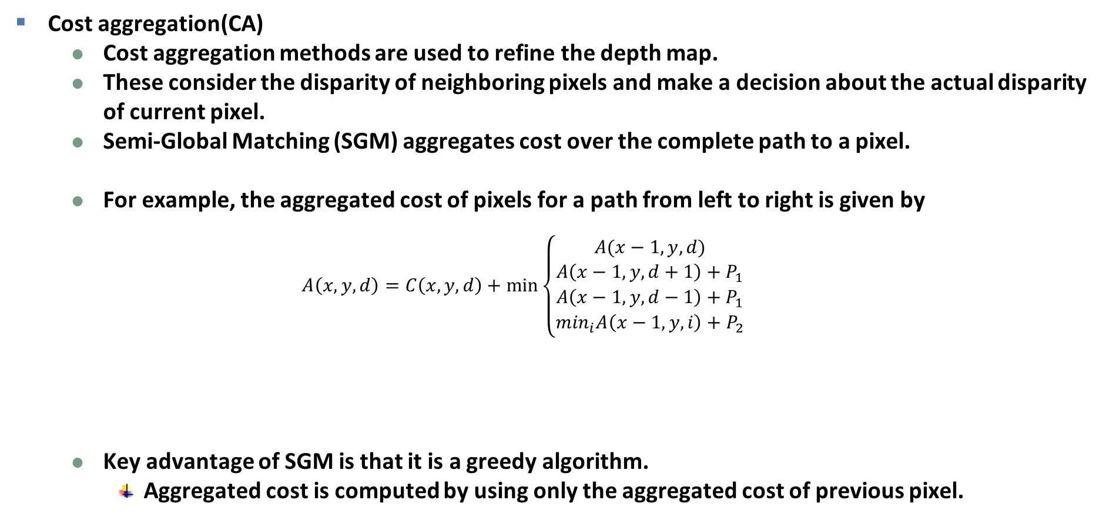
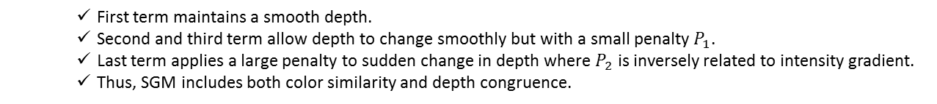
Post-Processing
Cost aggregation(CA)
Cost aggregation methods are used to refine the depth map.
These consider the disparity of neighboring pixels and make a decision about the actual disparity of current pixel.
Semi-Global Matching (SGM) aggregates cost over the complete path to a pixel.
For example, the aggregated cost of pixels for a path from left to right is given by
$$A\left(x,y,d\right)=C\left(x,y,d\right)+\min\left\{\begin{aligned}A(x−1,y,d) \\ A\left(x−1,y,d+1\right)+P_{1} \\ A\left(x−1,y,d−1\right)+P_{1} \\ \min_{i}A\left(x−1,y,i\right)+P_{2}\end{aligned}\right.$$
Key advantage of SGM is that it is a greedy algorithm.
Aggregated cost is computed by using only the aggregated cost of previous pixel.
First term maintains a smooth depth.
Second and third term allow depth to change smoothly but with a small penalty $P_{1}$.
Last term applies a large penalty to sudden change in depth where $P_{2}$ is inversely related to intensity gradient.
Thus, SGM includes both color similarity and depth congruence.

Slide 20
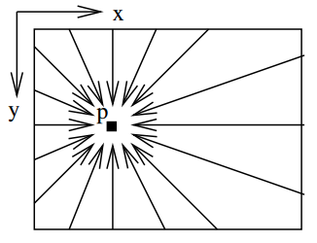
Post-Processing
Number of paths
In the papers, authors use 16 paths to the pixel.
Using 8 paths also provide decent results.
However, for hardware implementation, using only 4 paths is feasible.
For this, we have to maintain the aggregated costs of all pixels above and one to the left of the given pixel.
(a)
(b)
(c)
(d)
(e)
Fig. 0.10. (a) The number of paths proposed in the original paper, (b) the number of paths that can be used for hardware implementation, (c) Reference image, (d) SGM result with high image PSNR and (c) SGM result with low image PSNR

Slide 21
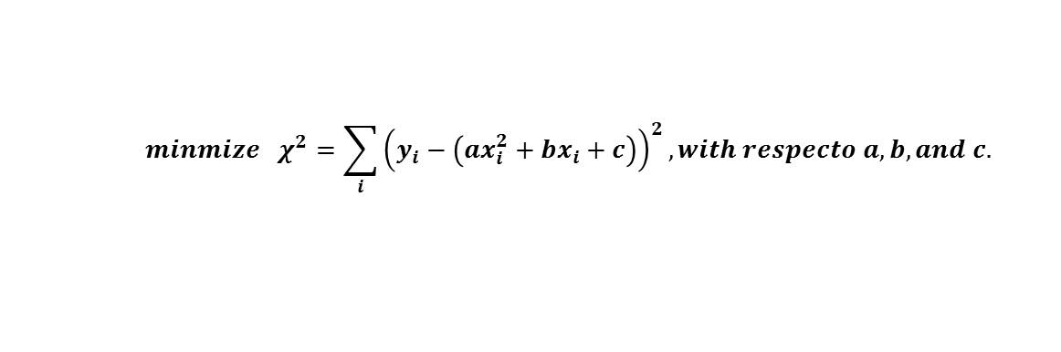
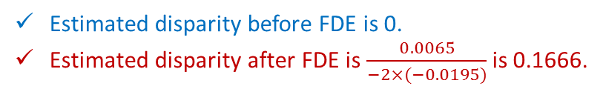
Post-Processing
Fractional disparity estimation(FDE)
Fractional disparity extraction can be utilized to increase the depth resolution.
By applying curve-fitting to a second-order polynomial, we extract fractional disparity.
$$minmize χ^{2}=\sum_{i}{{\left(y_{i}−\left(ax_{i}^{2}+bx_{i}+c\right)\right)}^{2}}, with respecto a, b, and c.$$
Example:
Estimated disparity before FDE is 0.
Estimated disparity after FDE is $\frac{0.0065}{−2×(−0.0195)}$ is 0.1666.

Slide 22
Experimental Environments
Camera
CIS model : Hi231 - 4 color (RGB IR)
CIS resolution : 1956x1232 (2.4M) 10bits
Lens type : M12 (CCTV lens)
Focal length : 8mm
Test aperture (unit : mm)
Test light source
Fluorescent
1.5
1.5
RGB
IR
3.5
5

Slide 23
Results
Disparity resolution
106cm
6cm ~ 106cm
(interval : 1cm, 101 levels)
<Test setting>
Image size : 978x616 10bits
Color channel : Red
Focus distance : 40cm
Patch size : 75x35
Search range : -30 ~ 7 pixels
Light source : Fluorescent
…
6cm
<Test scene>
(a)
(b)
Fig. 0.11. (a) Test scene and (b) disparity-distance relationship.

Slide 24
Results
<Test setting>
Image size : 978x616 10bits
Color channel : Red
Focus distance : 40cm
Kernel size : 33x33
Search range : -20 ~ 5 pixels
Light source : Fluorescent
Fig. 0.12. Input scene

Slide 25
Results
<Test setting>
Image size : 978x616 10bits
Color channel : Red
Focus distance : 40cm
Kernel size : 33x33
Search range : -20 ~ 5 pixels
Light source : Fluorescent
(a)
Far
(b)
(c)
Near
Fig. 0.13. (a) Input scene, (b) sparse depthmap and (c) full depthmap.

Slide 26
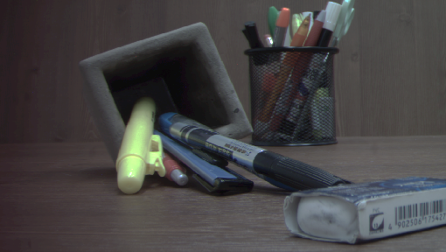
Results
<Test setting>
Image size : 978x616 10bits
Color channel : Red
Focus distance : 40cm
Kernel size : 33x33
Search range : -20 ~ 5 pixels
Light source : Fluorescent
Fig. 0.14. Input scene

Slide 27
Results
<Test setting>
Image size : 978x616 10bits
Color channel : Red
Focus distance : 40cm
Kernel size : 33x33
Search range : -20 ~ 5 pixels
Light source : Fluorescent
(a)
Far
(b)
(c)
Near
Fig. 0.15. (a) Input scene, (b) sparse depthmap and (c) full depthmap.

Slide 28
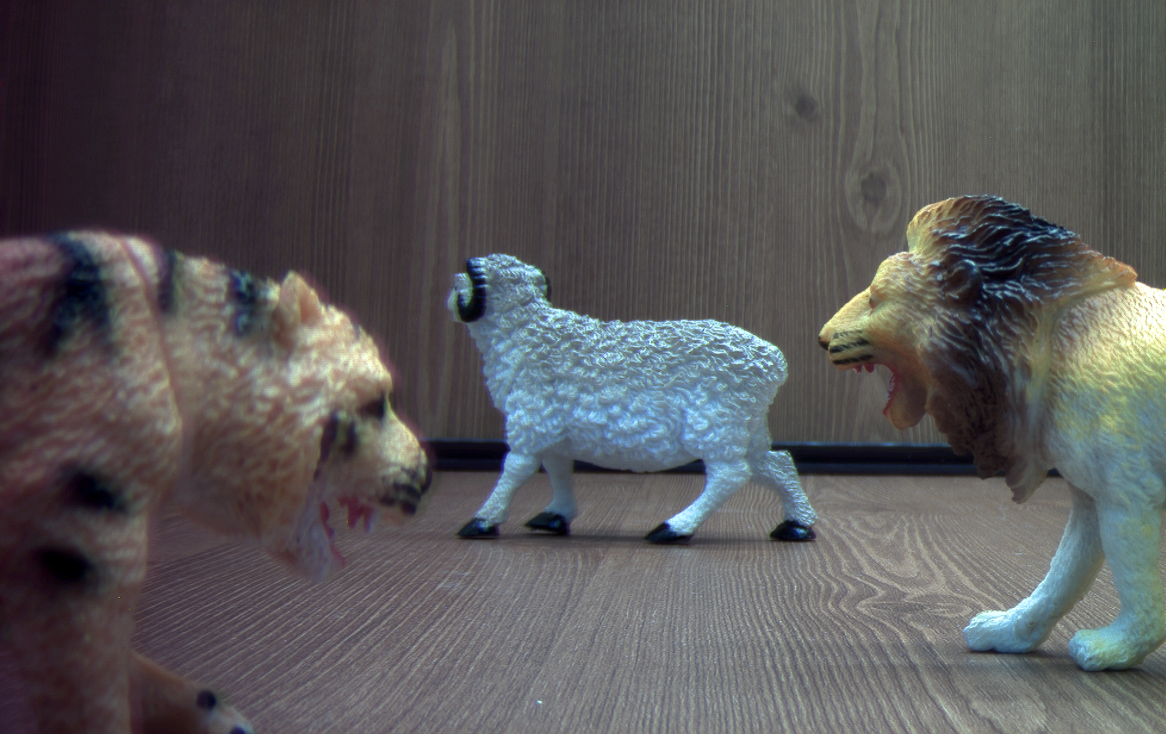
Results
<Test setting>
Image size : 978x616 10bits
Color channel : Red
Focus distance : 40cm
Kernel size : 33x33
Search range : -20 ~ 5 pixels
Light source : Fluorescent
Fig. 0.16. Input scene

Slide 29
Results
<Test setting>
Image size : 978x616 10bits
Color channel : Red
Focus distance : 40cm
Kernel size : 33x33
Search range : -20 ~ 5 pixels
Light source : Fluorescent
(a)
Far
(b)
(c)
Near
Fig. 0.17. (a) Input scene, (b) sparse depthmap and (c) full depthmap.

Slide 30
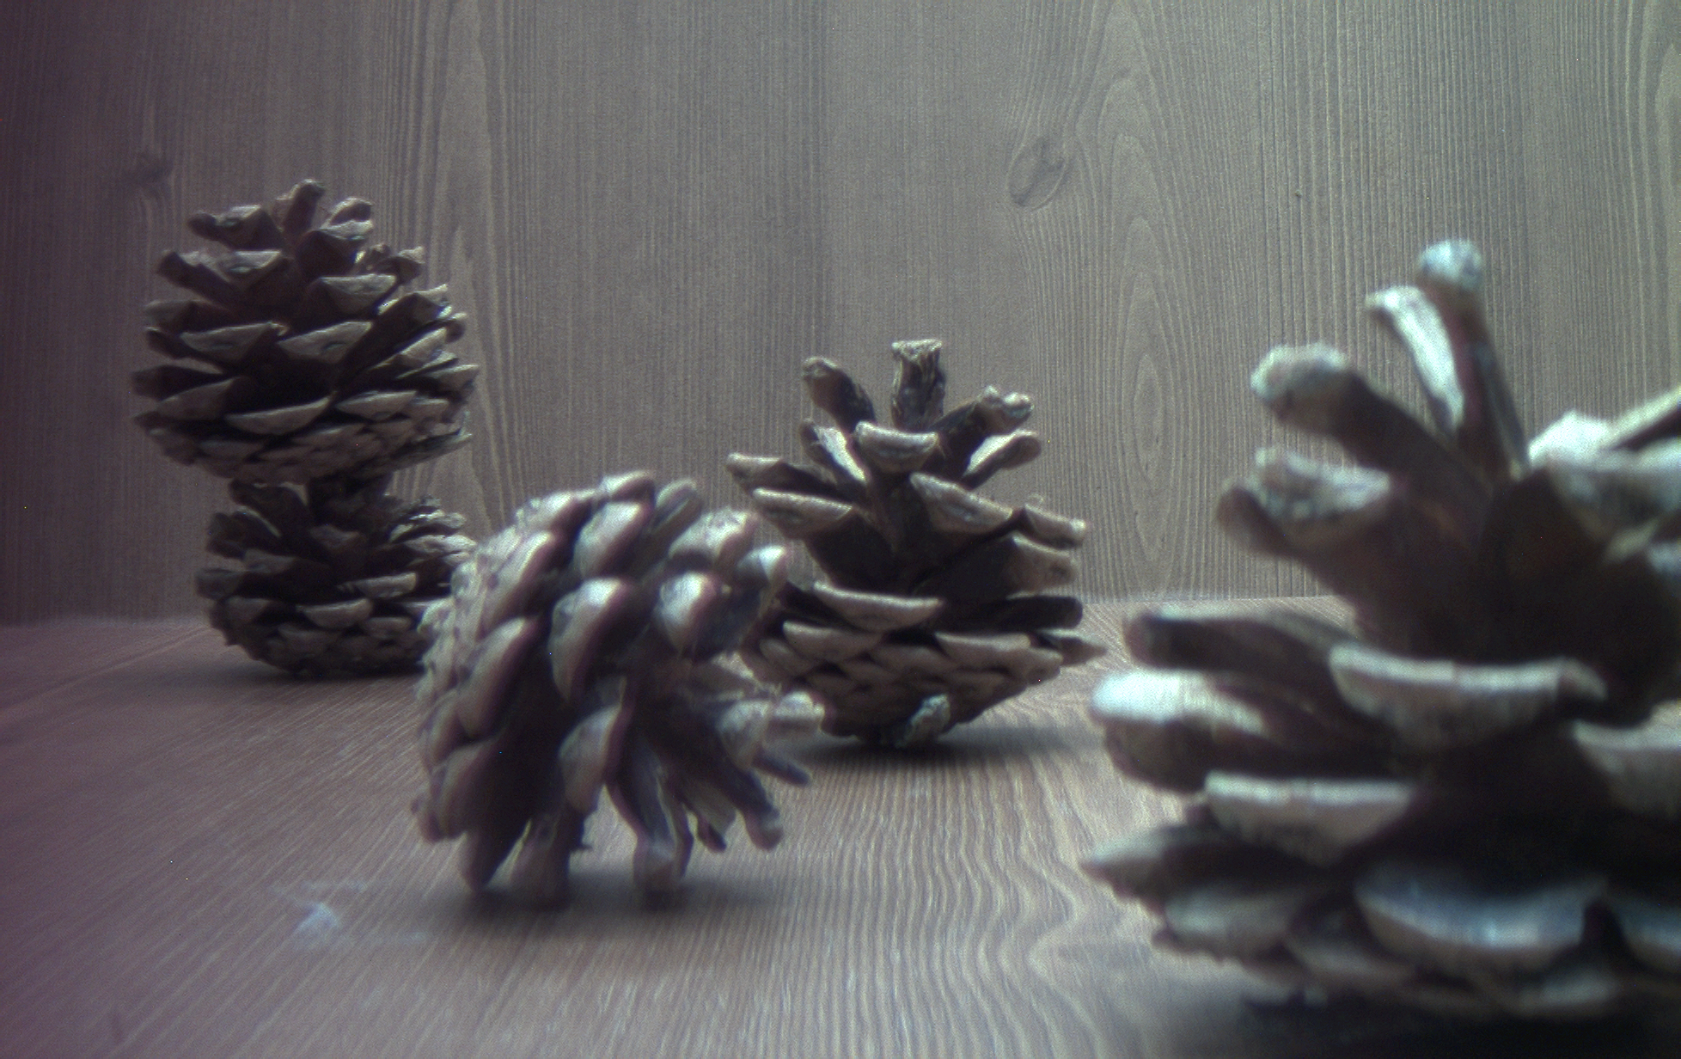
Results
<Test setting>
Image size : 978x616 10bits
Color channel : Red
Focus distance : 40cm
Kernel size : 33x33
Search range : -20 ~ 5 pixels
Light source : Fluorescent
Fig. 0.18. Input scene

Slide 31
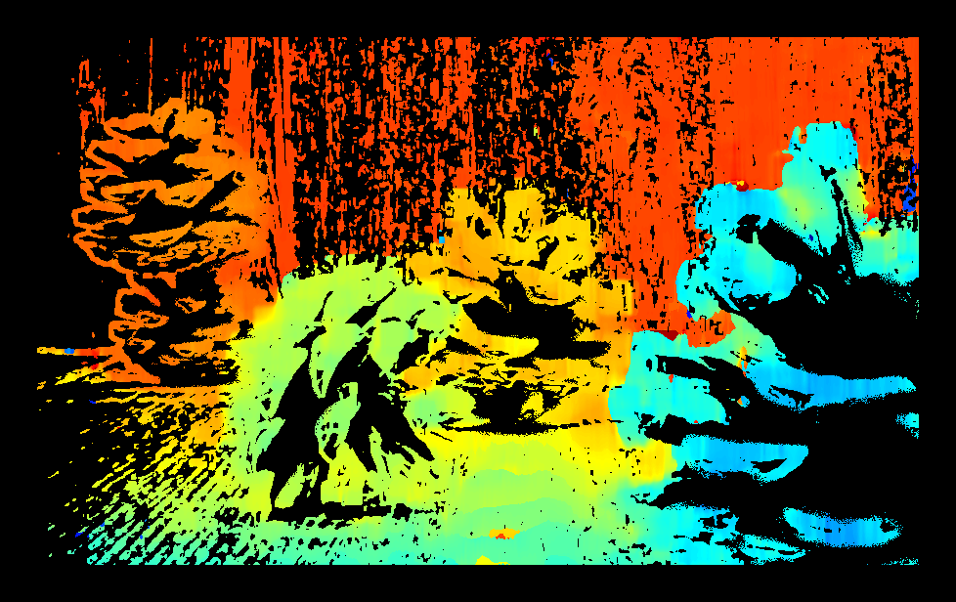
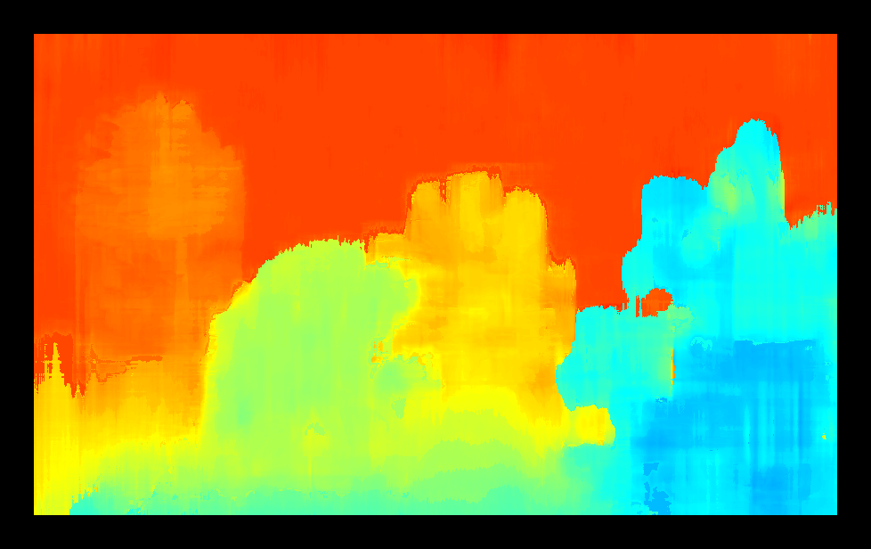
Results
<Test setting>
Image size : 978x616 10bits
Color channel : Red
Focus distance : 40cm
Kernel size : 33x33
Search range : -20 ~ 5 pixels
Light source : Fluorescent
(a)
Far
(b)
(c)
Near
Fig. 0.19. (a) Input scene, (b) sparse depthmap and (c) full depthmap.

Slide 32
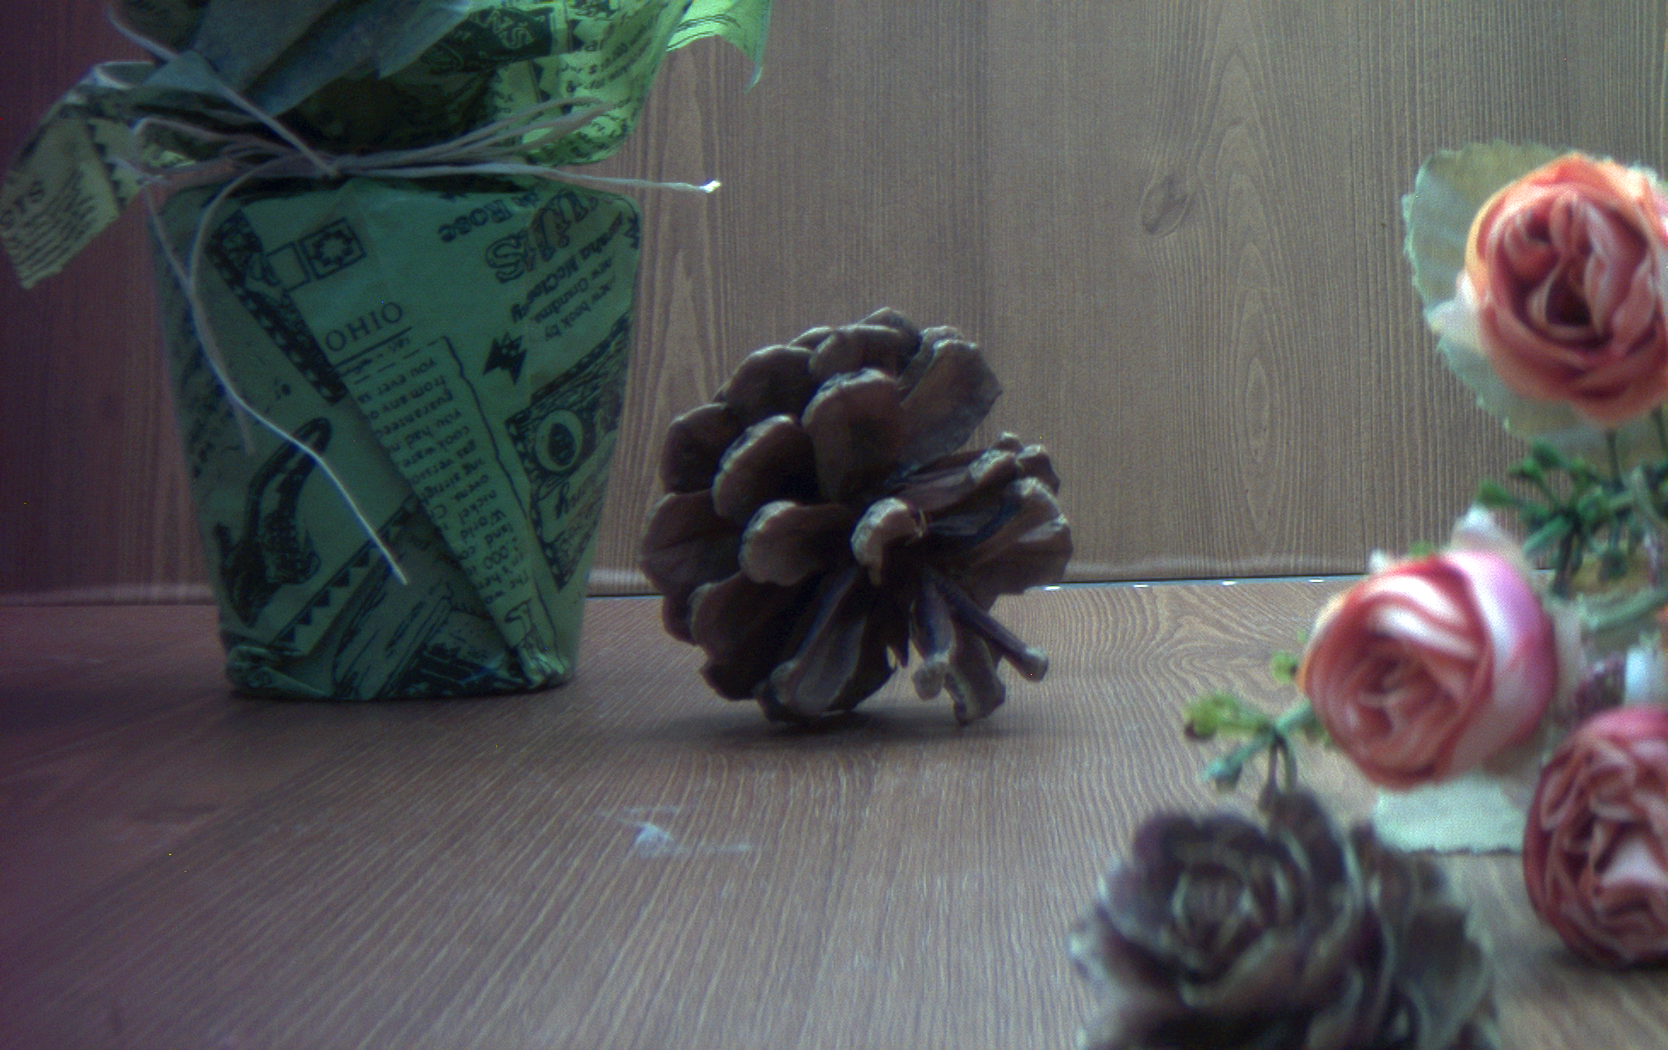
Results
<Test setting>
Image size : 978x616 10bits
Color channel : Red
Focus distance : 40cm
Kernel size : 33x33
Search range : -20 ~ 5 pixels
Light source : Fluorescent
Fig. 0.20. Input scene

Slide 33
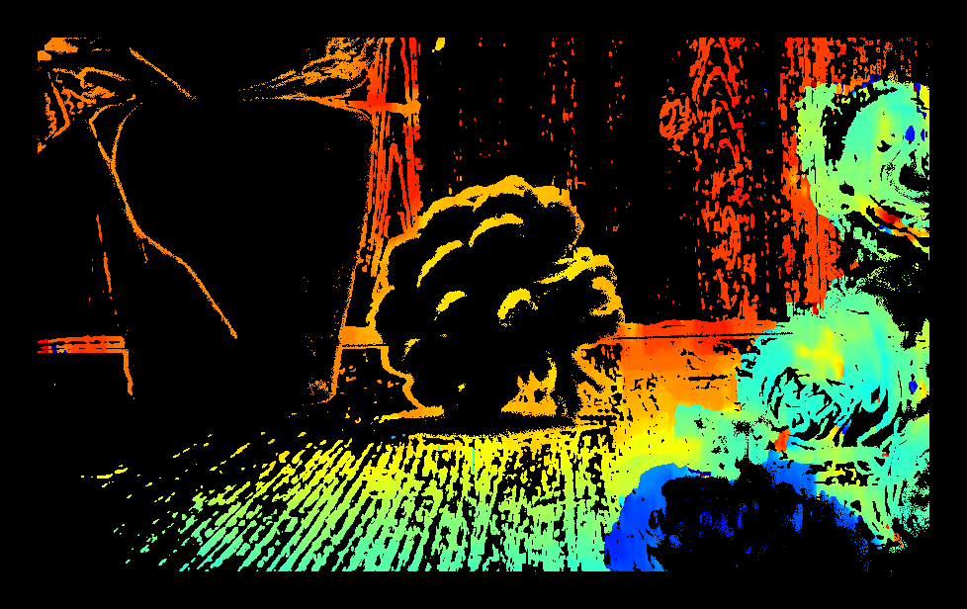
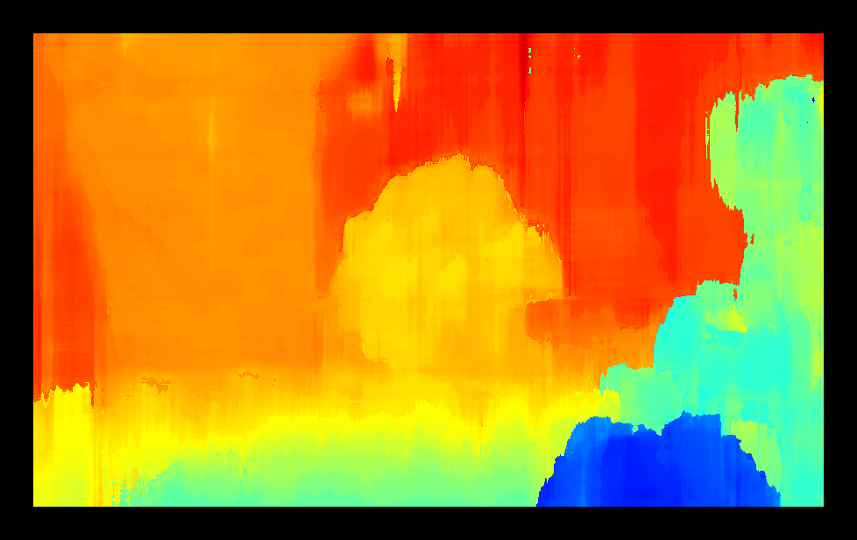
Results
<Test setting>
Image size : 978x616 10bits
Color channel : Red
Focus distance : 40cm
Kernel size : 33x33
Search range : -20 ~ 5 pixels
Light source : Fluorescent
(a)
Far
(b)
(c)
Near
Fig. 0.21. (a) Input scene, (b) sparse depthmap and (c) full depthmap.

Slide 34
Execution Time
(unit : seconds)
Total exe. time : 1.401 s
Total exe. time : 2.323s
Fig. 0.22. Computation time of OAIP

Slide 35
1. Leakage Compensation(LC)

Slide 36
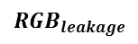

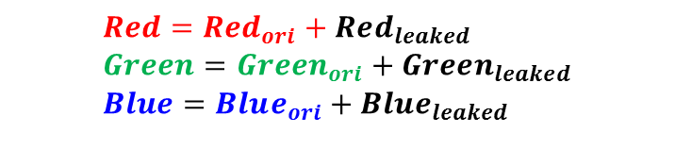

Pre-Processing
Leakage compensation
Since the RGB and IR response curves overlap, crosstalk occurs between the RGB and IR images.
We compensate for the cross-spectral crosstalk by subtracting scaled signals.
Correction is performed using the following equations.
$$\left[\begin{matrix}Refined_Red \\ Refined_Green \\ Refined_Blue\end{matrix}\right]=\left[\begin{matrix}Red \\ Green \\ Blue\end{matrix}\right]−\left[\begin{matrix}K_{IR2R} \\ K_{IR2G} \\ K_{IR2B}\end{matrix}\right]∙Refined_IR$$
$$Red=Red_{ori}+Red_{leaked} \\ Green=Green_{ori}+Green_{leaked} \\ Blue=Blue_{ori}+Blue_{leaked}$$
$$IR=IR_{ori}+IR_{leaked}$$
$$RGB_{leakage}$$
$${IR}_{leaked}$$
(a)
(b)
Fig. 1.1. Leakage from (a) RGB to IR and from (b) IR to RGB.

Slide 37
Functional Overview
Calculating leakage ratio by spectral analysis
We observe spectrum distribution with different light sources, aperture filters and sensor filters.
To exclude the effect of surface reflectance, we use a white checker in the experiments.
Refinement model
We perform weighted subtraction of one image from another.
The weight is directly proportional to the leakage ratio which is defined in coming slides.
We compute 4 parameters
R to IR ratio
IR to Red ratio
IR to Green ratio
IR to Blue ratio

Slide 38
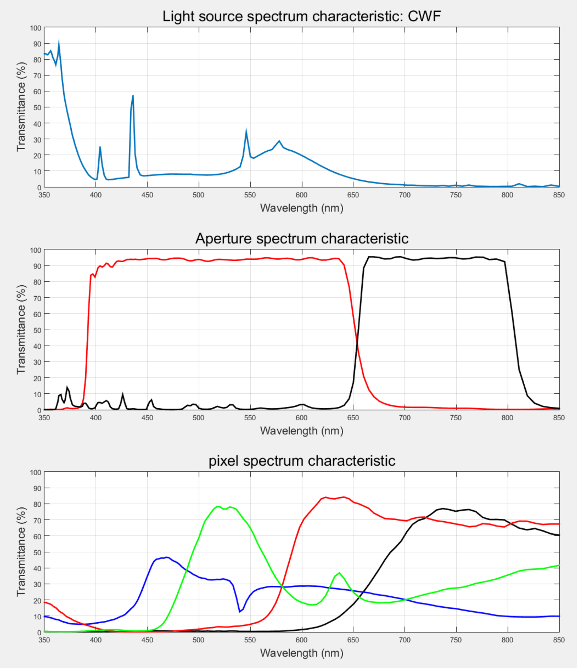
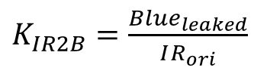
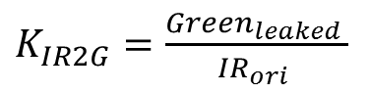



Functional Description
Refinement model
Spectral analysis was performed to compute leakage ratio.
$Refined IR =IR – K_{R2IR}∙Refined Red$
Cut the IR rays
Capture the white image
→
(a)
$$K_{R2IR}=\frac{IR_{leaked}}{{Red}_{ori}}$$
$$\left[\begin{matrix}Refined_Red \\ Refined_Green \\ Refined_Blue\end{matrix}\right]=\left[\begin{matrix}Red \\ Green \\ Blue\end{matrix}\right]−\left[\begin{matrix}K_{IR2R} \\ K_{IR2G} \\ K_{IR2B}\end{matrix}\right]∙Refined_IR$$
Cut the RGB rays
Capture the out-focus images of white target in various light conditions
→
(b)
$K_{IR2R}=\frac{{Red}_{leaked} }{IR_{ori} }$
$K_{IR2G}=\frac{Green_{leaked} }{IR_{ori} }$
$K_{IR2B}=\frac{Blue_{leaked}}{IR_{ori}}$
Fig. 1.2. (a) The white checker used in the experiments and (b) the ideal spectral response.

Slide 39




Functional Results
Far
(a)
(b)
(c)
(d)
(e)
(f)
Fig. 1.3. Results at CWF light source (a) RGB image, (b) IR image, (c) depthmap before leakage compensation and (d) RGB image, (e) IR image, (f) depthmap after leakage compensation.
Near

Slide 40




Functional Results
Far
(a)
(b)
(c)
(d)
(e)
(f)
Fig. 1.4. Results at TL84 light source (a) RGB image, (b) IR image, (c) depthmap before leakage compensation and (d) RGB image, (e) IR image, (f) depthmap after leakage compensation.
Near

Slide 41




Functional Results
Far
(a)
(b)
(c)
(d)
(e)
(f)
Fig. 1.4. Results at U35 light source (a) RGB image, (b) IR image, (c) depthmap before leakage compensation and (d) RGB image, (e) IR image, (f) depthmap after leakage compensation.
Near

Slide 42
Functional Results
<Aperture shape>
Depth map result at U35
Far
(a)
(c)
RGB
IR
<Test setting>
Image size : 978x616 10bits
Color channel : Red
Focus distance : 15cm
Patch size : 35x35
Search range : -16 ~ 7 pixels
Light source : U35
(b)
Near
Fig. 1.5. Results at U35 light source (a) RGB image, (b) IR image, (c) original depth map

Slide 43

Functional Results
<Aperture shape>
Depth map result at U35
Far
(a)
(c)
RGB
IR
<Test setting>
Image size : 978x616 10bits
Color channel : Red
Focus distance : 15cm
Patch size : 35x35
Search range : -16 ~ 7 pixels
Light source : U35
$$K_{R2IR}=0.1642$$
$$K_{IR2R}=1.1005$$
$$K_{IR2G}=0.8810$$
$$K_{IR2B}=0.8764$$
(b)
Near
Fig. 1.6. Results at U35 light source (a) RGB image, (b) IR image, (c) leakage compensated depth map

Slide 44
2. Noise Reduction(NR)

Slide 45
Introduction
The aim of noise reduction is to reduce the noise of raw images to improve the accuracy of edge extraction and depth estimation by
Enhancing Signal to Noise Ration (SNR), and
Preserving edges and textures in the image.
Far
(a)
(b)
Near
(c)
Fig. 2.1. (a) Input scene, (b) depthmap from noisy input images and (c) depthmap from temporally averaged (high PSNR) images.

Slide 46
Functional Overview
There are numerous noise reduction methods available.
These include
Fixed kernel filters (Box, Gaussian)
Guided filter (GF)
Bilateral filter (BF) and Directional Bilateral filter (DBF)
BM3D
We have evaluated these methods based on PSNR and Depthmap improvement.
BF and DBF have shown the best performance based on quantitative and qualitative depthmap evaluation.
Considering computational complexity, BF was decided to be the suitable candidate for OA.

Slide 47

Functional Description
Bilateral Filter
The objective of bilateral filtering is to smoothen the image while preserving textures and edges.
Contrary to standard fixed kernel filters (Box, GF), which only take into account the geometrical proximity of pixels, BF considers intensity similarities as well.
Filtered output q_{i} is calculated by
i: current pixel location
j: neighbor pixel location
The parameters $σ_{d}$ and $σ_{r}$ control the sensitivity of the filter in domain and range respectively.

Slide 48
Functional Results
Table I
Percent of bad depth and mean square error of disparity
Method | Error% | MSE
Box | 42% | 10.6
GF | 46.3% | 10.3
BM3D | 48% | 15.6
BF | 36% | 8.1
BF shows better performance in terms of depth classification error percentage and MSE
This comes from the fact that these filters preserve details within the image, which is important in stereo matching
Reference
Box
BF
(a)
(b)
(c)
(d)
Fig. 2.2. (a) Reference image, (b) depthmap extracted from the noisy image, (c) depthmap extracted from temporally averaged image (benchmark) and (d) depthmap extracted after applying bilateral filter to input images.

Slide 49
3. Integer Disparity Estimation(IDE)

Slide 50
Introduction
Disparity evaluation is based on comparison of stereo images.
Best match for each pixel in the reference image is searched for in the target image.
To find the best match, different similarity metrics are used.
OA presents a unique challenge as the two stereo images are at a different scale and may not be correlated.
For this, a similarity metric is needed which is robust against radiometric differences.

Slide 51
Functional Overview
Numerous similarity metrics were compared against each other.
These include
Normalized Sum of Absolute difference (NSAD)
Normalized Cross Correlation (NCC)
Zero mean Normalized Cross Correlation (ZNCC)
Census Transform (CT)
Rank Transform (RT)
Weighted Census Transform (WCT)
Modified Weighted Census Transform (MWCT)
The results of these approaches with different images were distributed amongst five participants who voted NCC and ZNCC to be the best similarity metrics.

Slide 52
Functional Description
The NCC between two patches A and B is given by
The ZNCC between two patches A and B is given by
NCC compensates for the scale difference between two patches.
ZNCC compensates for the difference of mean value between the two patches as well as the scale difference.

Slide 53






Functional Results
Input scene
NCC result
ZNCC result
Fig. 3.1. Results of sparse depthmap generation.

Slide 54
4. Cost Aggregation(CA)

Slide 55
Introduction
Cost volume aggregation is a method to refine depth using the depth of neighborhood pixels.
Cost aggregation can be broadly classified into two approaches.
Local Cost Aggregation
These approaches consider the local neighborhood of a pixel to refine depth.
Examples are box filter, bilateral filter, and guided filter.
Global Cost Aggregation
These approaches consider pixels beyond the local neighborhood of an image to refine depth.
Examples include Semi-global Matching (SGM) and Graph-cuts.

Slide 56
Functional Overview
Cost volume is a 3D structure.
Each location of the cost volume stores the pixel-wise cost.
See accompanying figure for graphical illustration.
Applying a box filter to each slice of
the cost volume is equivalent to using an equal weight window for matching.
Applying a bilateral filter to each slice
of the cost volume is equivalent to
using weights based on color similarity and proximity.
Applying a guided filter to each slice o
the cost volume is equivalent to using
guided filter weights for aggregation.
Fig. 4.1. A depiction of the disparity volume. The disparity volume is made up of 5
slices (the disparity levels). Typically
cost volume maintains the SAD values,
however, in our case it stores the NCC
values.

Slide 57
Functional Description
Semi-Global Matching (SGM) [1] aggregates cost over the
complete path to a pixel.
For example, the aggregated cost of pixels for a path
from left to right is given by
In our implementation we use four or eight paths.
We emphasize using four paths as these are feasible
for hardware implementation.
Fig. 4.2. Four paths feasible for
hardware implementation.
[1] Hirschmüller, Heiko. "Accurate and efficient stereo processing by semi-global matching and mutual information." Computer Vision and Pattern Recognition, 2005. CVPR 2005. IEEE Computer Society Conference on. Vol. 2. IEEE, 2005.

Slide 58
Functional Results
(a)
(b)
(c)
Fig. 4.3. (a) Input scene, (b) result of SGM on a low PSNR image and (c) result of SGM on a high PSNR image.

Slide 59
5. Fractional Disparity Estimation(FDE)

Slide 60


Functional Description
Fractional disparity extraction can be utilized to increase the depth resolution.
Nearly universal formulation of fitting: minimize squares of differences between data and function
Example: for fitting a second-order polynomial, minimize
$$χ^{2}=\sum_{i}{{\left(y_{i}−\left(ax_{i}^{2}+bx_{i}+c\right)\right)}^{2}}$$ with respect to $a$, $b$ and $c$.
Most general solution technique: take derivatives with regard to unknown variables, set equal to zero.
Example:
Estimated disparity before LSM is 0.
Estimated disparity after LSM is $\frac{0.0065}{−2×(−0.0195)}$ is 0.1666.
Fig. 3.1. Illustration of curve-fitting for increasing depth resolution.

Slide 61


Functional Description
Fractional disparity extraction can be utilized to increase the depth resolution.
Target : $y=ax^{2}+bx+c$
Samples: $\left(x_{1},y_{1}\right)$, $\left(x_{2},y_{2}\right), \left(x_{3},y_{3}\right)$
Interpretation: find x that comes “closest” to satisfying Ax=b
i.e., minimize b–Ax
i.e., minimize |b–Ax|
Equivalently, minimize |b–Ax|² or (b–Ax) ^{T}(b–Ax)
$$min{\left(b−Ax\right)}^{T}\left(b−Ax\right)$$
$$∇\left({\left(b−Ax\right)}^{T}\left(b−Ax\right) \right)=−2A^{T}\left(b−Ax\right)=\vec{0}$$
$$A^{T}Ax=A^{T}b$$
Compute $\hat{x}$=(A^{T}A)⁻¹ A^{T} , which is known as “pseudoinverse” of A
A
x
b
$$\left[\begin{matrix}x_{1}^{2} & x_{1} & 1 \\ x_{2}^{2} & x_{2} & 1 \\ x_{3}^{2} & x_{3} & 1\end{matrix}\right]\left[\begin{matrix}a \\ b \\ c\end{matrix}\right]=\left[\begin{matrix}y_{1} \\ y_{2} \\ y_{3}\end{matrix}\right]$$

